Slide 1
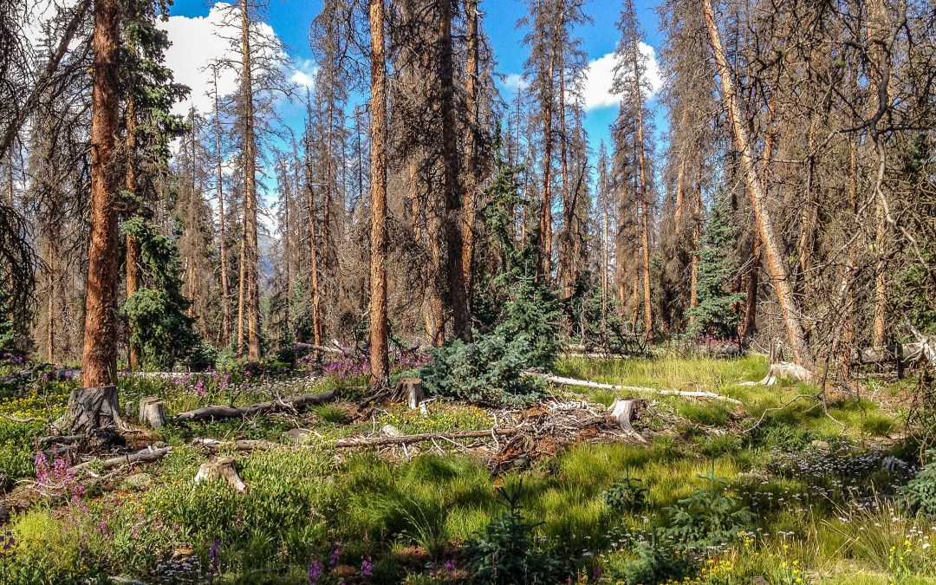
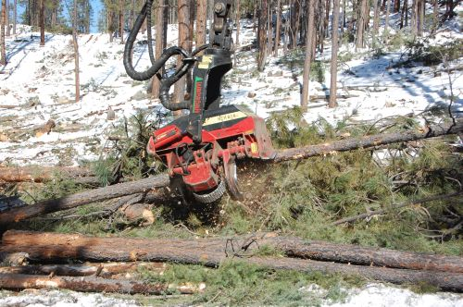
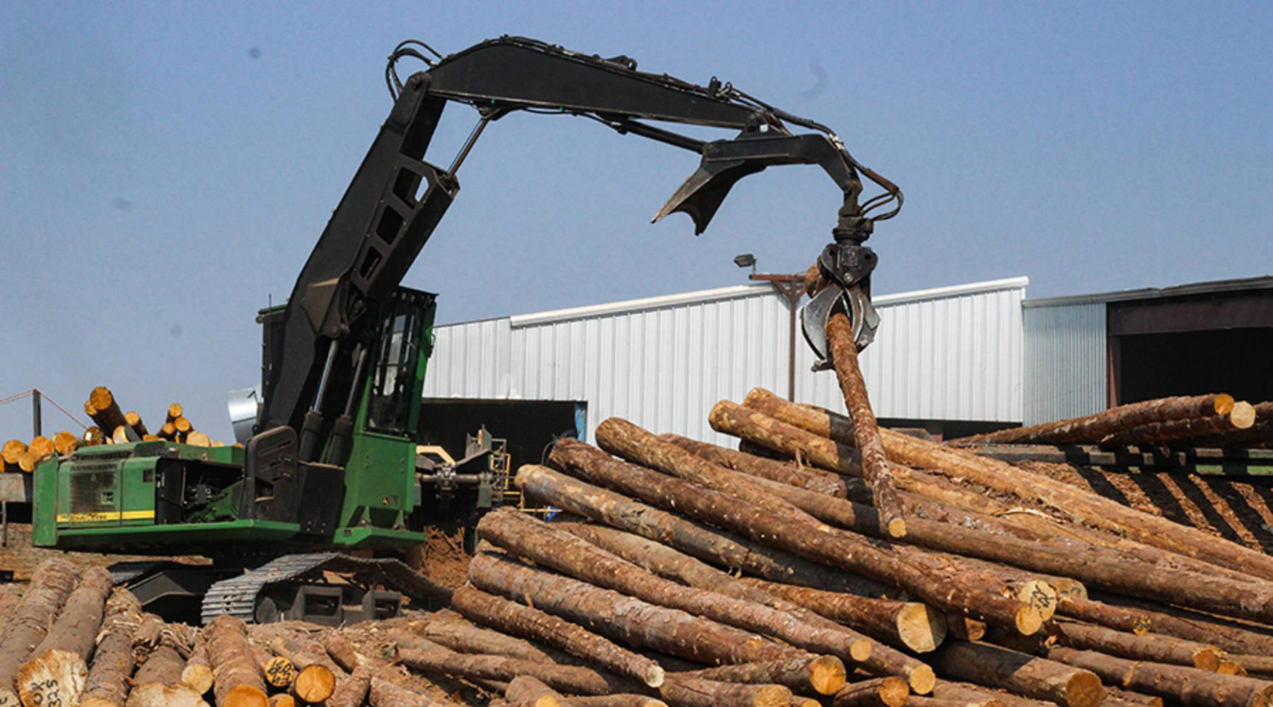
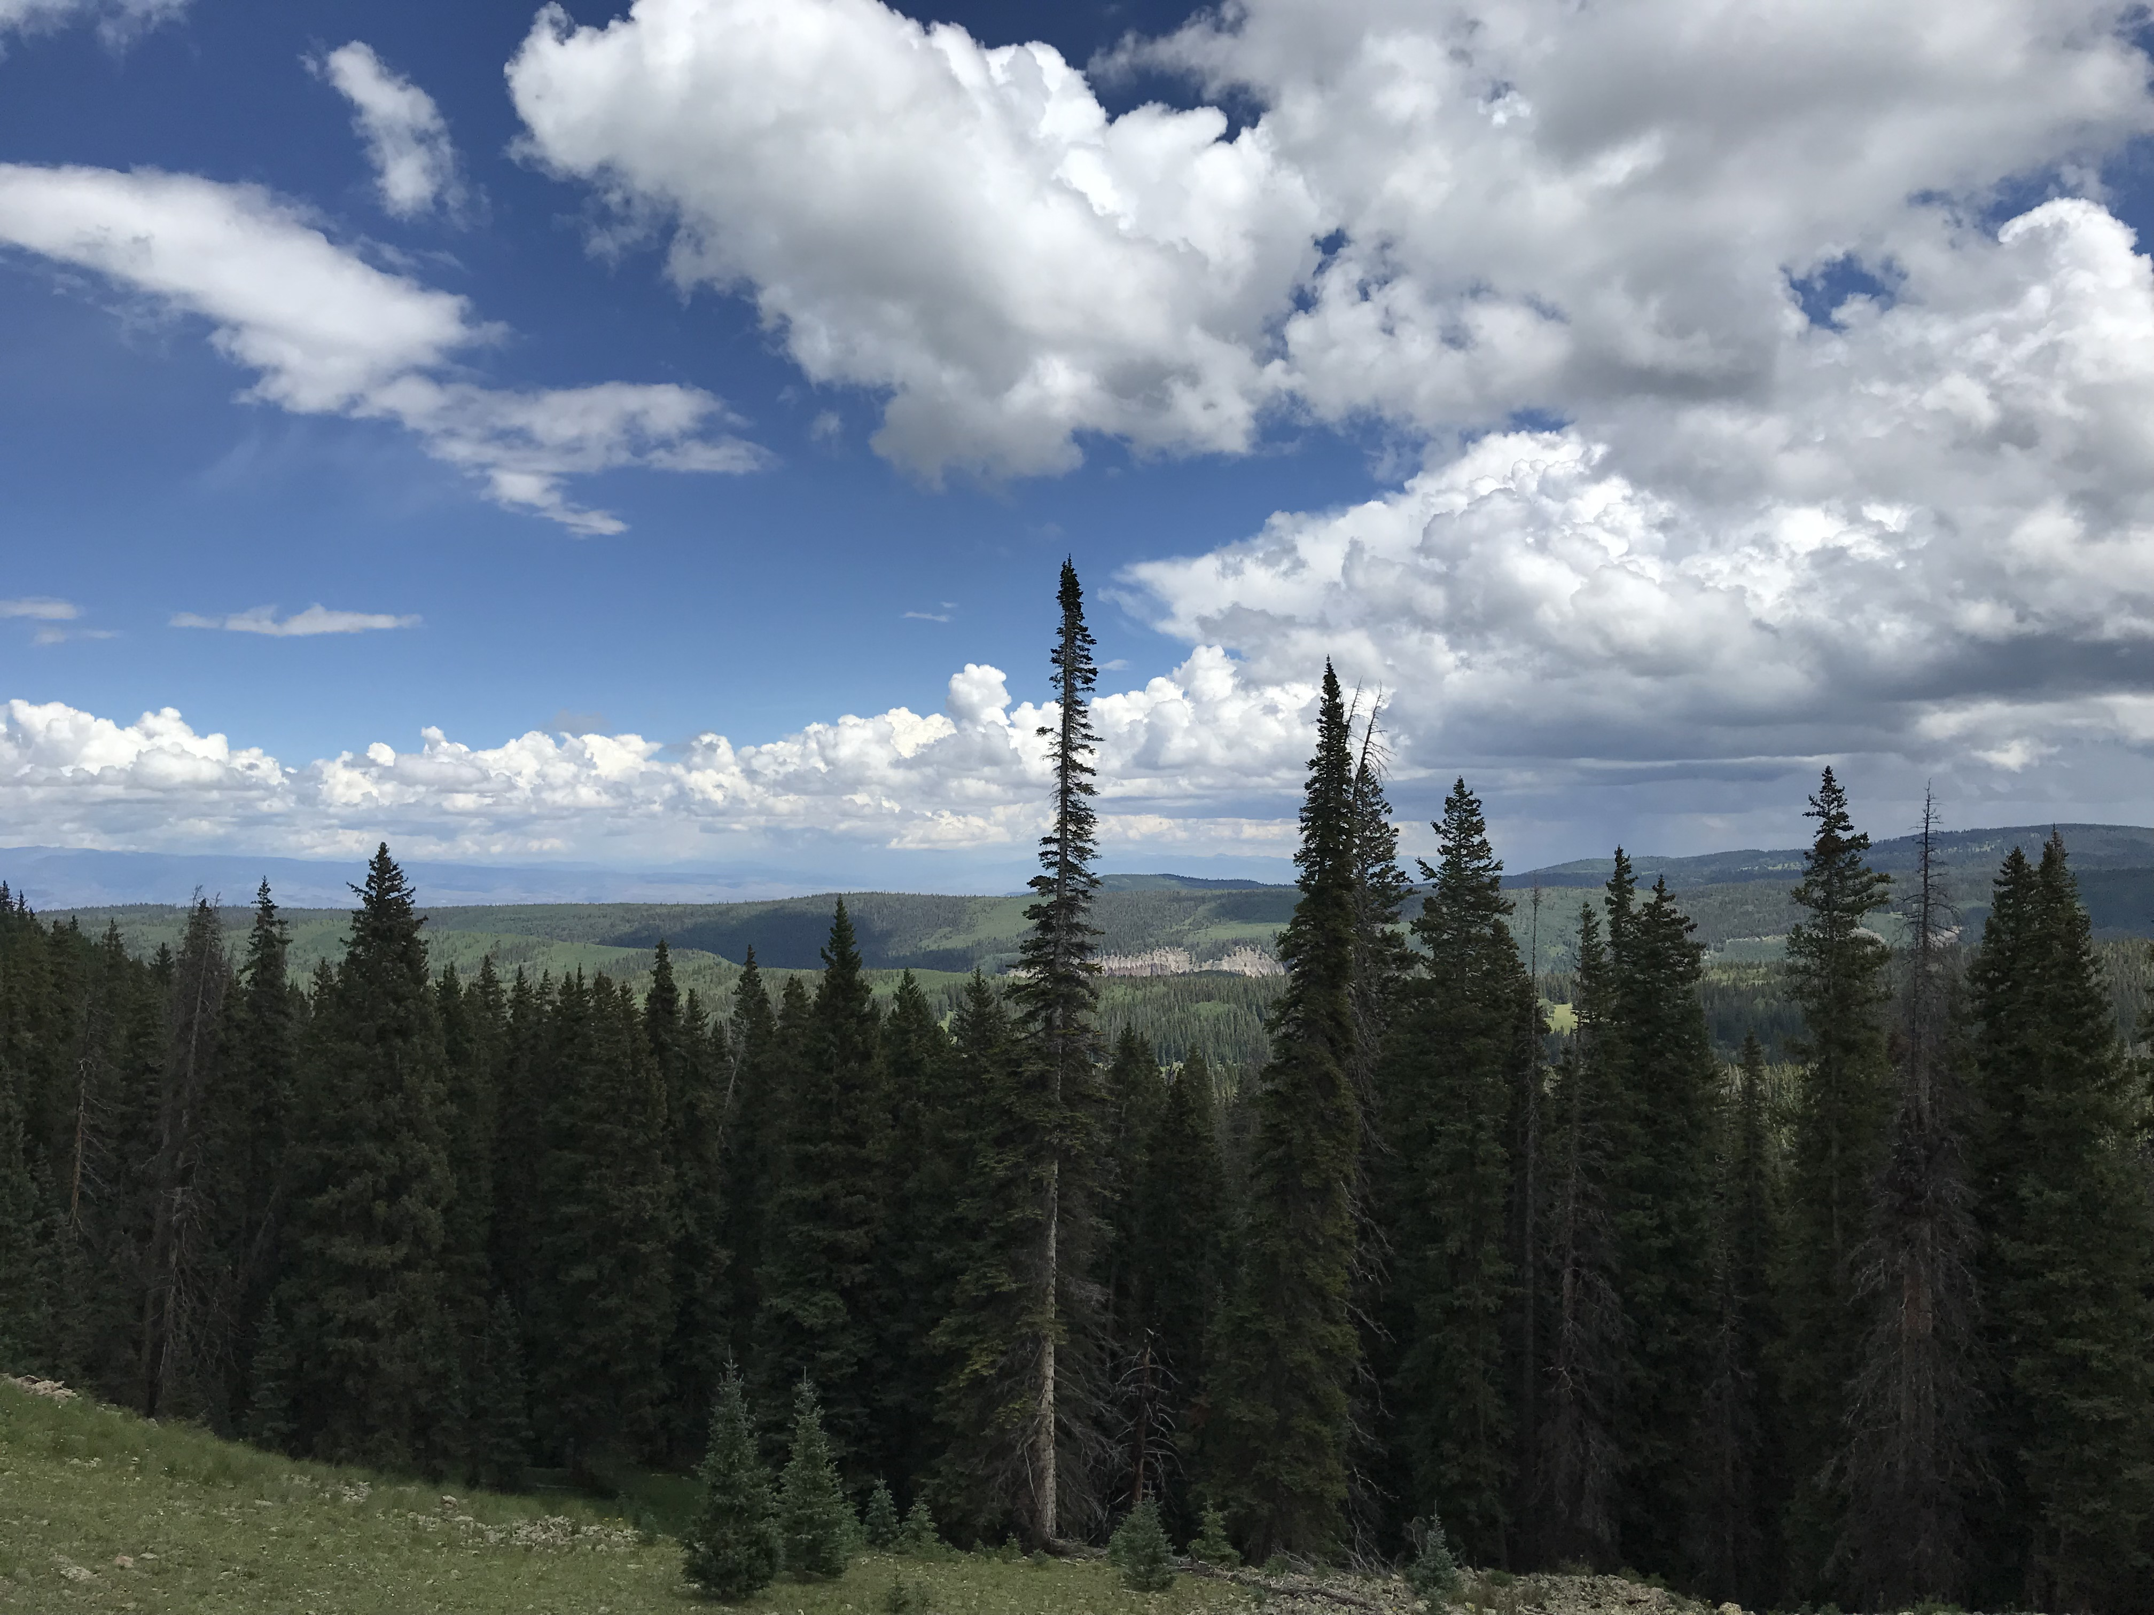

Spruce Beetle Epidemic-Aspen Decline Management Response – Adaptive Management Group: taking stock, looking ahead
Tony Cheng and Tyler Beeton
Colorado Forest Restoration Institute (CFRI), Colorado State University
tony.cheng@colostate.edu
Tyler.Beeton@colostate.edu

Slide 2

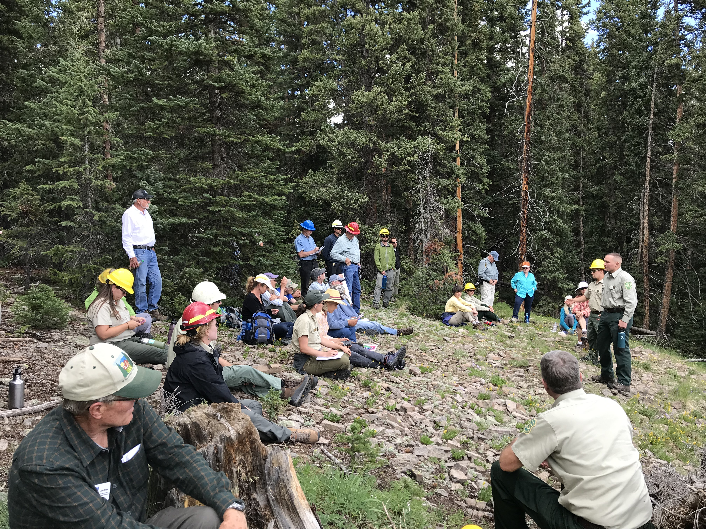
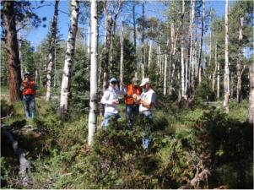
Setting the stage
Who is CFRI and why are we involved
Collaboration context of SBEADMR AMG
Taking stock so far: gaps between expectations and performance
Looking ahead: topics to consider

Slide 3
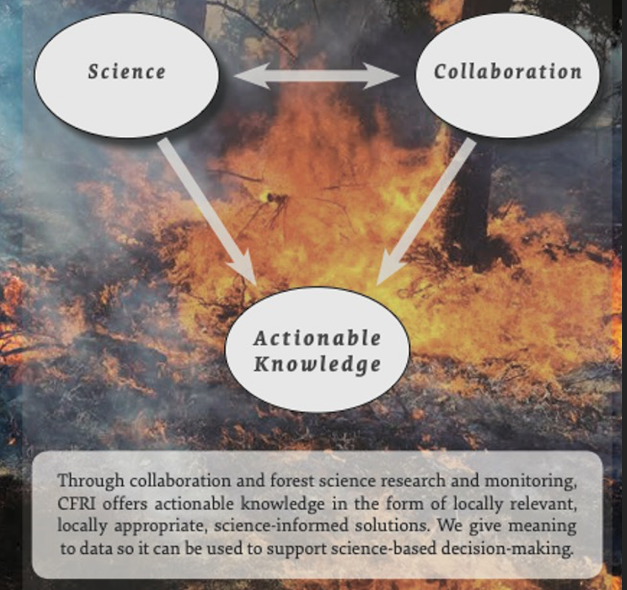
The Southwest Forest Health and Wildfire Prevention Act of 2004 (Public Law 108-317)
“An act to establish institutes to demonstrate and promote the use of adaptive ecosystem management to reduce the risk of wildfires and restore the health of fire-adapted forest and woodland ecosystems of the Interior West.”
https://cfri.colostate.edu/
Notes:
Brett

Slide 4
Collaboration context
Collaboration occurs when two or more individuals willingly work together to achieve mutually-desired outcomes they couldn’t have achieved alone.
Performance
Problem/Purpose
Process
People
Walker G, Severson G and Daniels S (2023) Collaborative Alignment: a framework for community-based collaboration for natural resource management... Front. Commun. 8:1228650. doi: 10.3389/fcomm.2023.1228650

Slide 5
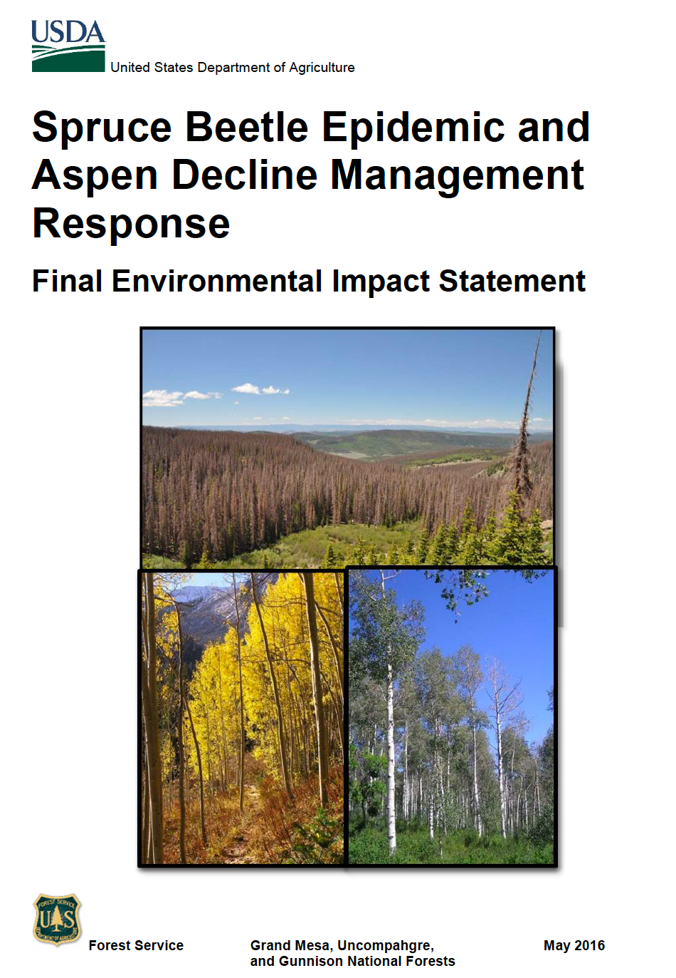
Collaboration context
Goals:
Reduce threats to public safety associated with large areas of dead trees (i.e., fire hazard, tree-fall danger)
Spur tree regeneration in the face of potential future forest loss
Increase the diversity of forest conditions across the landscape – stands of different tree sizes, ages, species- to withstand future stressors
Provide commercial forest products to local dependent industries
The Adaptive Management Group was intended to collaboratively assess the extent to which goals were achieved, using applied research and monitoring results developed by the Science Team and other subject-matter experts.

Slide 6
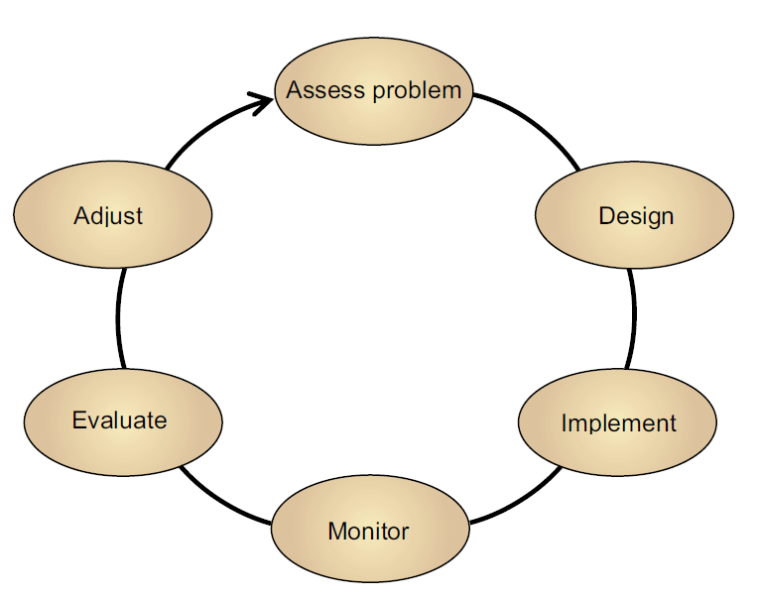
GMUG NF Spruce Beetle Epidemic-Aspen Decline Management Response (SBEADMR) Collaborative Adaptive Management
Steering Committee
Monitoring
Committee
Adaptive Management Group
GMUG Forest Leadership Team
General public
USFS Rocky Mtn Research Station
Science Team
GMUG Resource Specialists
CO State Univ. – Sibold Lab, CFRI
CO Parks & Wildlife
W. CO Univ.

Slide 7
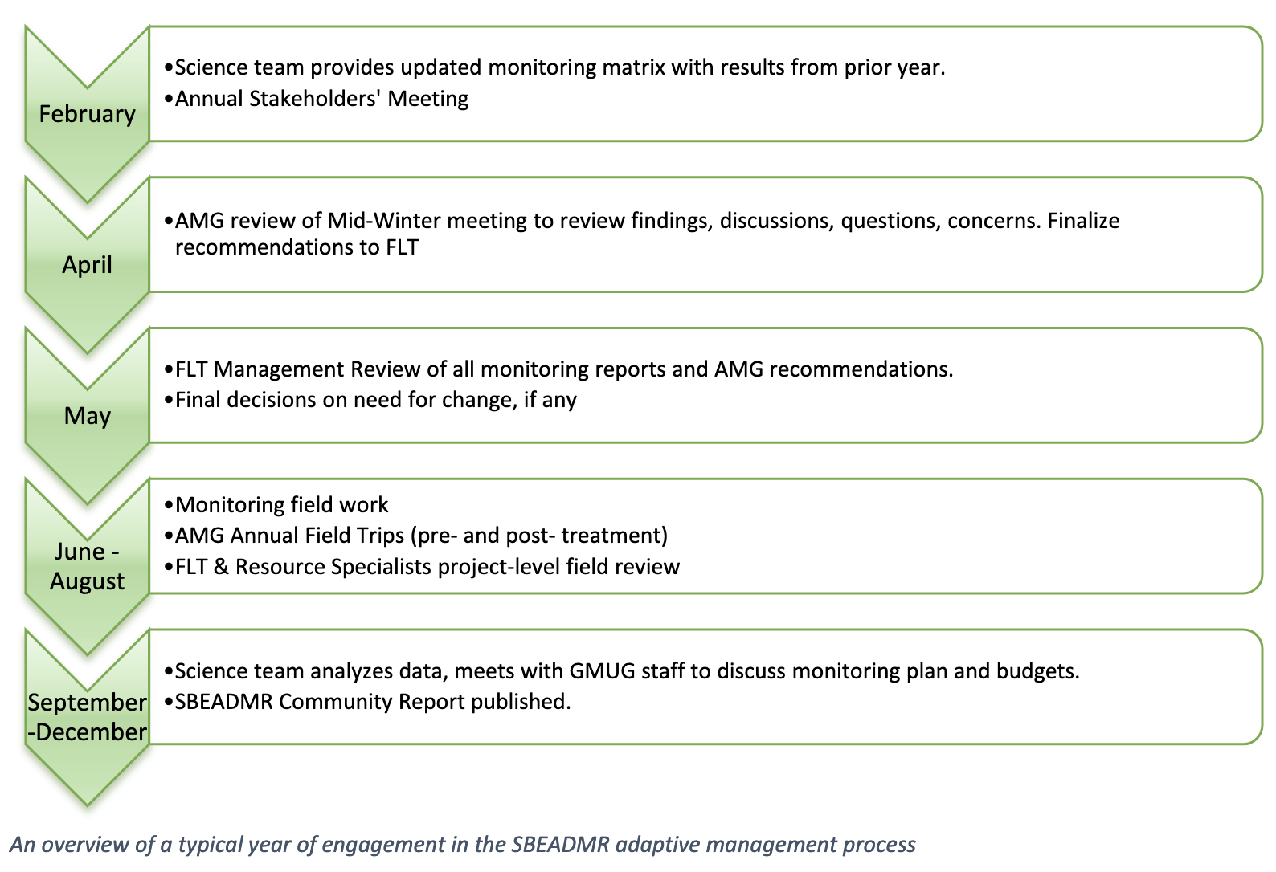
SBEADMR Adaptive Management Process and Products
https://cfri.colostate.edu/wp-content/uploads/sites/22/2022/02/SBEADMR2022CommunityReport2022-1.pdf

Slide 8
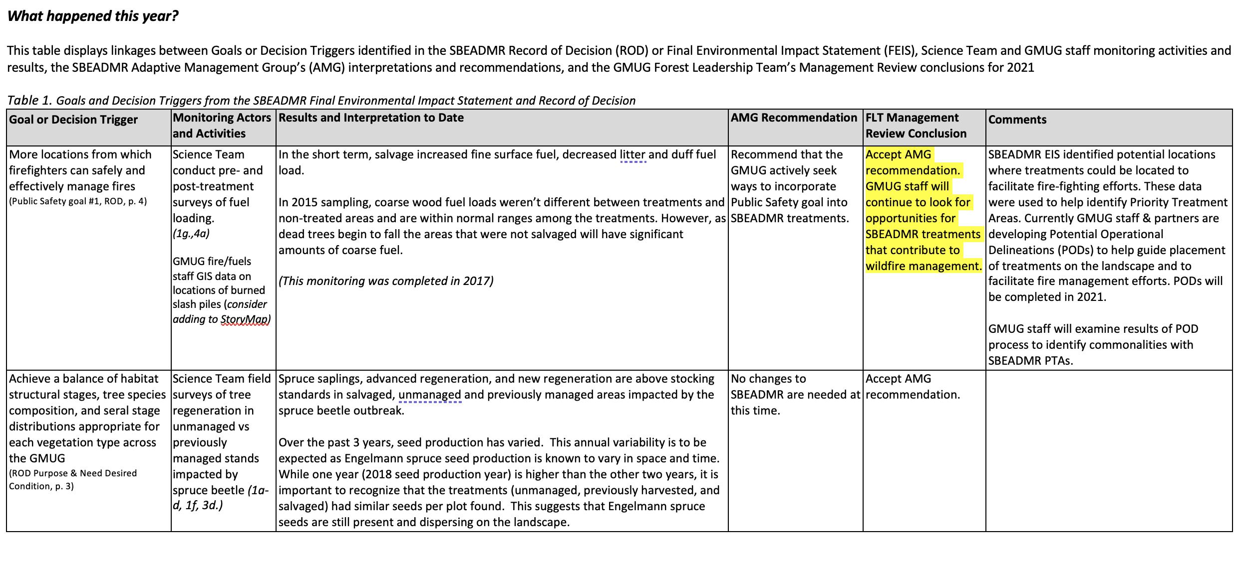
SBEADMR Adaptive Management Documentation: example from Adaptive Management Group’s Annual Report

Slide 9
Assessing collaboration: expectations, capacities, roles and commitment
Stakeholder’s expectations, interests, capacity, and commitment to participate
[Laws, regulations, policies]
[Available people, $$, time]
Operating/ Decision Space for 4 P's
Agency staff expectations, capacity, and commitment to participate
Leadership’s expectations and commitment to process and outcomes
[Top-down and local change drivers]

Slide 10
Is the collaborative adaptive management process functioning as it was originally intended in FEIS and expected by participants?
Key informant interviews
12 semi-structured interviews
Baseline information on how SBEADMR meeting goals, participant expectations, successes, challenges, recommendations
Questionnaire
Online (Qualtrics)
Grounded in findings from interviews
Piloted by SBEADMR participants
Administer to – FLT, AMG, Science Team, Resource Specialists, partners, public
Distribution – SBEADMR Listserv – 53 usable responses (30% of sample)

Slide 11
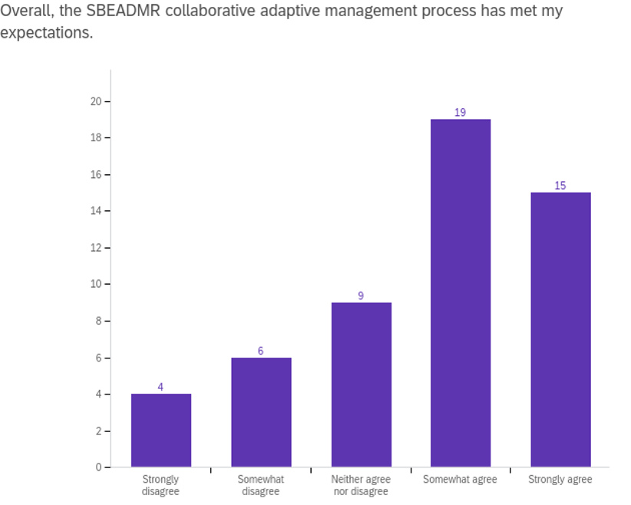
Goals/Objectives of the SBEADMR Adaptive Implementation process
Develop shared understanding, priorities, and agreements to accomplish work and solve problems
Ensure treatment implementation is responsive to conditions on the ground, new scientific information, and public input
Compliance with EIS/ROD
Conduct a transparent adaptive implementation process
Continue collaborative engagement and participation throughout the process
Notes:
Goals/Objectives of SBEADMR Adaptive implementation process (Appendix E)
AMG assist GMUG with applying the adaptive management framework
Expectations – 19% strongly to somewhat disagreed; 16% neutral; 65% agree to strongly agree

Slide 12
Aligning expectations on the 4 Ps
Agreement on purpose - the how and why
Function of:
Salvage vs. Resiliency treatments
Scale of SBEADMR
Ponsse
Turnover
Notes:
Figure showing percent agree to strong agree that participants agree about strategies to solve problems and the purpose of the project – not a lot of agreement.
Function of:
Agreement on the problem and purpose are fundamental components of working together - disagreement in the how and the why is likely to also cause misalignment in perspectives on collaborative process and performance….

Slide 13
Aligning expectations on the 4 Ps
Agreement on purpose - the how and why
Salvage vs. Resiliency
Is we are kind of moving out of the salvage game and into the green game. People could really rally behind clear cutting, essentially, large swaths of dead spruce to reduce fuel hazards, reduce the potential of a big, huge mega fire, and the impacts associated with that. As we're pushing into resiliency treatments, artificially creating breaks in this contiguous forest, it's getting harder and harder for some of our…partners, to be like, "Is this really going to help? What's the benefit?"
Turnover
Another big challenge is changing faces…because you build trust, you build relationship with [someone], and then they move on. And then you get somebody else in there. And they look at this [project/process and think], "Okay, what are you guys doing? I don't like this." And that's happened several times.
Scale/Scope of SBEADMR impacts
[It was a challenge] to really differentiate what is information that is relevant for the forest plan monitoring [vs. SBEADMR]. Things like recreation are well beyond a timber management project. They have a lot to do with other types of management decisions that the GMUG is or isn't making, as well as larger socioeconomic demographic drivers that are out of the control of the foresters.
Notes:
When considering the strategies to solve problems, salvage vs resiliencey
Related to the scope/scale of SBEADMR

Slide 14
Aligning expectations on the 4 Ps
COLLABORATION THROUGHOUT PROCESS – Decision Space

Slide 15
Aligning expectations on the 4 Ps
COLLABORATION THROUGHOUT PROCESS – Decision-space
Appendix E a roadmap
The framework for the adaptive management process as outlined in Appendix E has provided the road map for implementation for the adaptive management process. All partners, e.g. USFS, Science Team, AMG and Forest Leadership Team (FLT) have all adhered to that roadmap and work diligently to meet the objectives and timeframes for the adaptive management process. In that sense the process has met my expectation.
Increase dialogue with FLT
Great interaction with members of the AMG and Forest staff participating in the meetings and field trips but no interaction with Forest leadership (rangers and supervisor). I expected the AMG to have more influence on the direction/prioritization of the timber program in response to spruce beetle
Expected more engagement in planning
I was under the impression during the EIS that we were developing a traditional collaborative and...we would be at least able to have discussions and detailed ones with the Forest Service and kind of influence how it was going to be managed that way. But instead we're looking at, the Forest Service develops the plans still, we react to those... The implementation part of it is very excellent to be plugged into that. But the planning part of it is what's still…I expected to be more engaged with that, I guess.
Scope of comments considered
The other big challenge is with public comments…a lot of comments, [were] comments you would get in a normal NEPA - comments that have already been addressed in the EIS, right.
Notes:
Structured process like SBEADMR and documented Adaptive Implementation Process can still lead to variable perspectives of how to interpret and understand the plug-in points/allowable decision space, for example:
Some participants expected more involvement on the back end of the adaptive management cycle…
More dialogue with AMG after recommendations made in terms of what adaptations were made and why
More engagement in planning (front-end) – expected more meaningfully engagement to inform discussions related to the treatment design - i.e., there wasn’t enough resolution in out-year planning for meaningful engagement
NEPA – this project represented a new way of doing business – most collaborative engagement occurs pre-Implementation, and thus reasonable to expect that public comments may reflect this – in fact, represented by this exemplar.

Slide 16
Aligning expectations on the 4 Ps - The CFLRP
SWERI (CFRI) asked to monitor collaborative governance for all CFLRP projects.
Newly authorized and re-authorized projects have similar challenges and needs
Key Challenges
Turnover
Capacity to engage – time, personnel
Key needs
Identifying clear roles and accountability
Developing process for transparent decision making processes and adaptive management
Aligning expectations for engagement throughout the process

Slide 17
Conclusions and Next Steps
Clear "plug-in" points
Clear and consistent communication on:
  Agreed upon expectations for 4 P's
  Decision-space
  Roles and commitment of each party in collaboration
  Why and how things change

